Slide 1




Automated Currency Classification Using CNN
Project 8

Slide 2

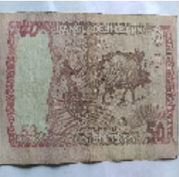

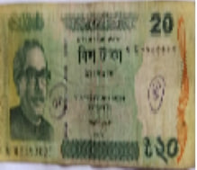
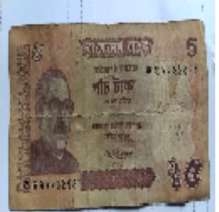
We want to know what
denomination this banknote is .
Connor Hamilton
bois

Slide 3




Why Automated Currency Classification?
The Problem: Manual counting is slow, prone to errors, and risky (Counterfeits).
Efficiency: Traditional methods limit the speed of ATMs and Vending Machines.
Social Impact (Accessibility): Helping visually impaired individuals identify currency independently.
Our Solution: A robust CNN model to automate detection with high accuracy

Slide 4



DATASET Overview
Dataset Source: Bangladeshi Banknote Dataset (Kaggle).
Volume: 70,000+ images covering 8 Classes (Denominations).
Classes: 2, 5, 10, 20, 50, 100, 500, 1000 Taka.

Slide 5
Data Preprocessing & Augmentation
Standardization
Normalization
Data Augmentation
Scaling pixel intensity values to the range [0,1].
Accelerates gradient descent convergence
Label Encoding:
Converting categorical currency classes into One-Hot Encoded vectors.
Rotation (±20∘), Zoom (15%), Width/Height Shift (20%), Shear, & Horizontal Flip.
Simulates real-world variations (e.g., tilted or folded banknotes) to improve model robustness
Resizing all input images to 128×128 pixels.
Ensures uniform input dimensions for the CNN architecture

Slide 6
The Model Architecture
Architecture: Custom CNN.
Depth: 4 Sequential Blocks (Increasing Filters: 32 → 256).
Regularization: Batch Normalization & Dropout (to prevent overfitting).
Output Layer: Softmax Activation (8 Classes).

Slide 7


Training Configuration
Early Stopping: Prevents overfitting & saves time.
Model Checkpoint: Saves the best-performing weights.
ReduceLROnPlateau: Fine-tunes learning rate dynamically.
Metrics: Accuracy & Validation Loss
Optimizer
Adam(Adaptive Learning Rate)
Loss Function
Categorical Cross-Entropy

Slide 8

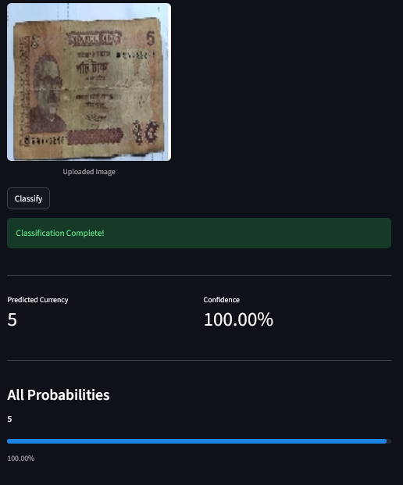

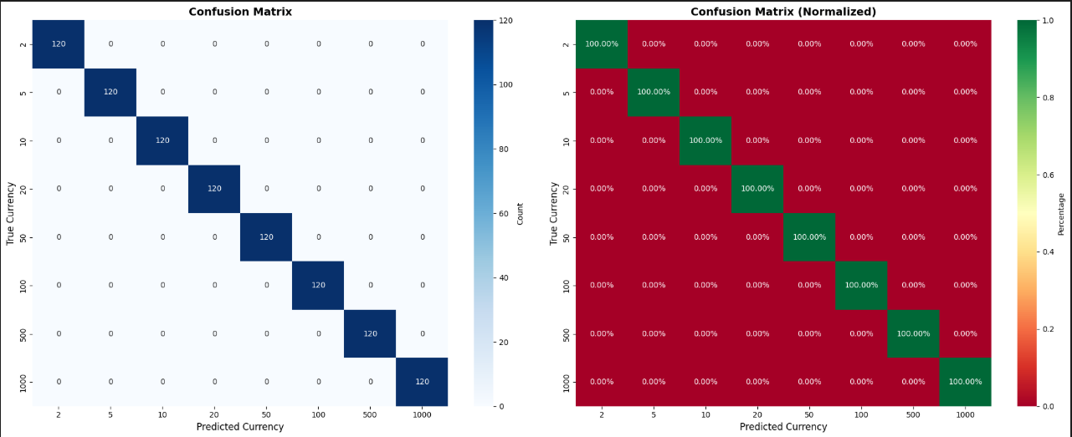
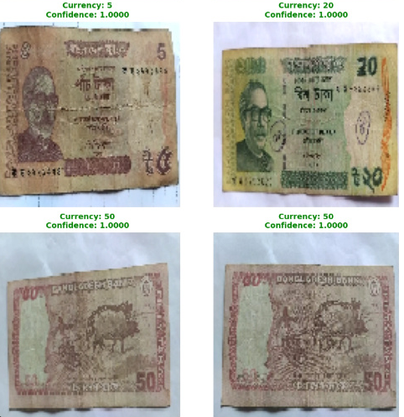
Result

Slide 9


Try our project
NOW IS DEPLOYED

Slide 10
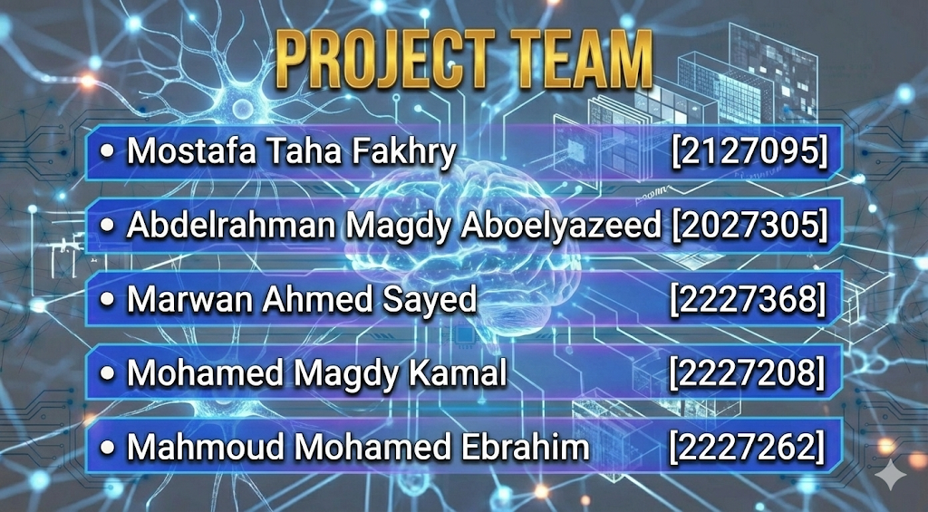

Slide 11
Thank Tou

